Slide 1
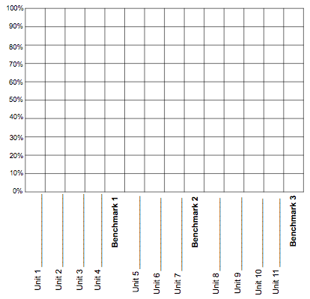
Teacher(s): Moore
The
Course Organizer
Student:
Time:
Course Dates:
This Course:
6th Grade Math
3
Course Standards:
1
Rational numbers (+/- fractions, decimals and percents), proportionality (ratios and rates), and algebraic concepts (expressions, equations, and inequalities) used in everyday life.
CONTENT:
Major Grades: Tests
Projects
Benchmarks
Daily Grades: Homework
Small Group work
Group Talk work
ThinkThroughMath
is
about
Course Questions:
When can you apply rational numbers, proportionality, and algebraic concepts to everyday life?
How do you generate equivalent forms of fractions, decimals and percents?
What helps you determine the operation needed to solve the problem or represent the expression?
How do we use ratios, rates and proportions to solve real world problems?
What multiple representations can we use to display data?
How do we use geometric properties and relationships to solve problems?
Why is it important to understand and apply personal financial concepts?
Course Progress Graph

Slide 2
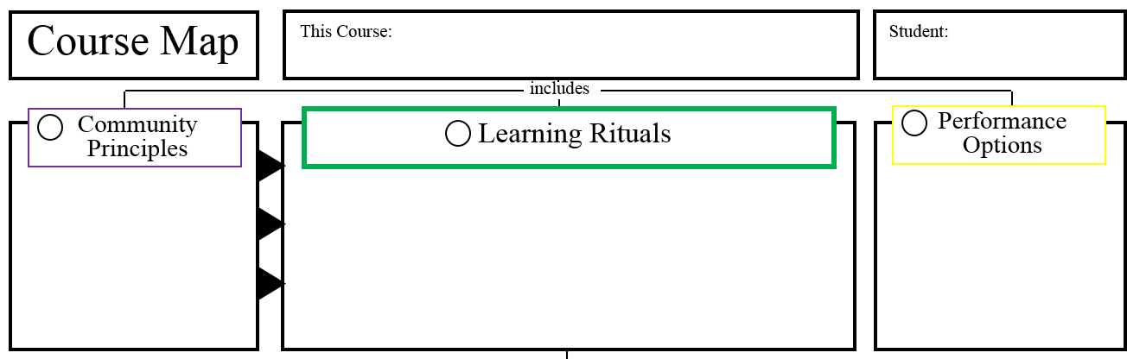
6th Grade Math
6
7
8
A E
C V
H E
I
Unit Organizers
FRAMEs
Materials
Model and Do
Project
Self-Questioning
Projects
Formative Assessments
Written work
Tutoring
Stations
Performance tasks
Independent Learning
Think Through Math
Cooperative learning
Feedback sessions
Warm-ups
Accountable talk

